Slide 1

SELENIUM - TestNG
Hoang Xuan Thanh

Slide 2

SeleniuM
Wikipedia: Selenium is a portable framework for testing web applications. Selenium provides a playback (formerly also recording) tool for authoring functional tests without the need to learn a test scripting language (Selenium IDE). It also provides a test domain-specific language (Selenese) to write tests in a number of popular programming languages, including C#, Groovy, Java, Perl, PHP, Python, Ruby and Scala. The tests can then run against most modern web browsers. Selenium deploys on Windows, Linux, and macOS platforms. It is open-source software, released under the Apache 2.0 license: web developers can download and use it without charge.
Notes:
Đưa ra định nghĩa trên Wikipedia để dằn mặt người xem

Slide 3
SeleniuM
Automation testing framework:
Free opensource solution
Objective: Web application
Selenium IDE
Selenium 3

Slide 4
TesTNG
TestNG is a testing framework for the Java programming language created by Cédric Beust and inspired by JUnit and NUnit. The design goal of TestNG is to cover a wider range of test categories: unit, functional, end-to-end, integration, etc., with more powerful and easy-to-use functionalities.

Slide 5
TesTNG
Mô tả các thiết lập khác nhau khi kiểm thử bằng file XML
Cung cấp các chỉ dẫn Annotation-based để nhận diện phương thức test
Xác lập cụ thể thời điểm cho các xử lý trước và sau
Phân nhóm kiểm thử
Tạo mối quan hệ ràng buộc lẫn nhau giữa các module

Slide 6
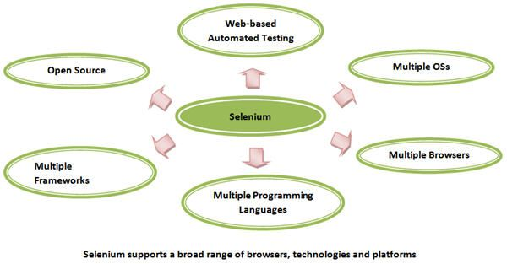
selenium Advantages

Slide 7
Tesnng Advantages
Test cases can be grouped easily and prioritized easily.
Ability to export HTML report
Possibilities of parallel execution of test cases and parameterization
It allows to define dependent test cases and each test case is independent to other test case.
Test cases can be executed on multiple browsers.
It supports integration with Maven, Jenkins etc.
Data driven approach
Assert class khá xịn xò

Slide 8
Installation
Java 8 SDK: Install and add environment path
Eclipse IDE 2018-09
Maven: Download and add environment path
Git: Install and add environment path
TestNG: TestNG plugin from Eclipse Marketplace
Selenium: Download driver: ChromeDriver, Firefox Driver,…

Slide 9
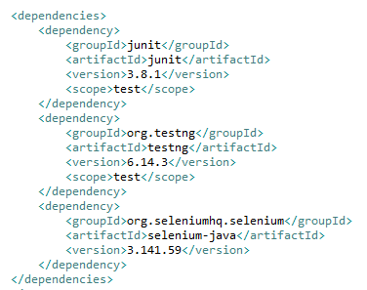
New Project
Default maven project
Dependencies:
org.testng.testng
org.seleniumhq.selenium.selenium-java

Slide 10
Initialize browser
Chrome:
System.setProperty("webdriver.chrome.driver", <path>);
driver = new ChromeDriver();
Firefox:
System.setProperty("webdriver.gecko.driver", <path>);
driver = new ChromeDriver();

Slide 11
Run test
Eclipse Run
Maven command
mvn clean test -DsuiteXmlFile=src/test/java/selenium/suite/suite.xml

Slide 12
Common Annotations
@BeforeSuite
@BeforeTest
@BeforeGroups
@BeforeClass
@BeforeMethod
@Test
@DataProvider
@Parameters
@AfterSuite
@AfterTest
@AfterGroups
@AfterClass
@AfterMethod

Slide 13
Assertions
Assert Equals
Assert True
Assert Same
Assert Null
Assert Not Equals
Assert Not True
Assert Not Same
Assert Not Null

Slide 14
Reference
https://testng.org/doc/documentation-main.html
https://www.w3schools.com/cssref/css_selectors.asp

Slide 15
EOS – End of Slides

